Slide 1
Happiness Index Analysis
Group C: Hannah Carrothers, Taryn Eliel, Olivia Ovenell

Slide 2
Overarching Topic
Human connection
Social interactions
Happiness Levels

Slide 3
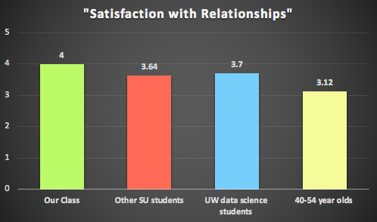
1st Domain
How satisfied are you with your personal relationships?
Averages:
Our class: 4
Other SU students: 3.64
UW data science: 3.7 40-54 yr olds: 3.12
Notes:
Hannah

Slide 4
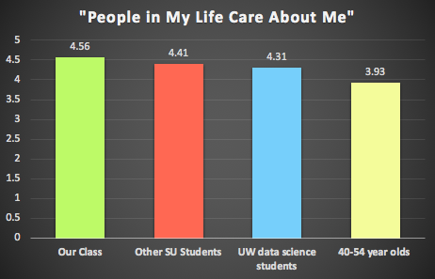
2nd Domain
To what extent do you agree with the following statement: People in my life care about me
Averages:
Our class: 4.56
Other SU students: 4.41
UW data science: 4.31
40-54 yr olds: 3.93
Notes:
Hannah

Slide 5
Possible Explanations
?
?
?
?
U-Bend of Life
People’s happiness tends to dip in middle age, and rise again with time, creating a U-Bend
Well-being suffers
Depression becomes more prevalent in middle age, and it may cause friction and/or distance with friends and family
Access to Institutional Resources
Universities give you access to a network of people & resources
Our class has learned about the importance of relationships on happiness
Friends, emotional support, healthcare, clubs, academic/career support, meals
Middle age folks may lose that social connection/not know where or how to access these things (not as easy)
Notes:
Liv

Slide 6
2-part survey
Respondents: 40 years old and above
Potential Test
Part 1
Related to U-Bend attributes such as how age affects personal relationships, & overall well-being, as well as, their perception of how others care about them.
Part 2
Focus on participants’ relationship to institutions, & how they may feel about the resources available to live a happy and healthy life.
Notes:
Taryn

Slide 7
Thanks!

