Slide 1
Happiness Index Analysis
Monica Kim | Ciara Loughnane |
Thomas Tran | Nicolette Voskericyan

Slide 2
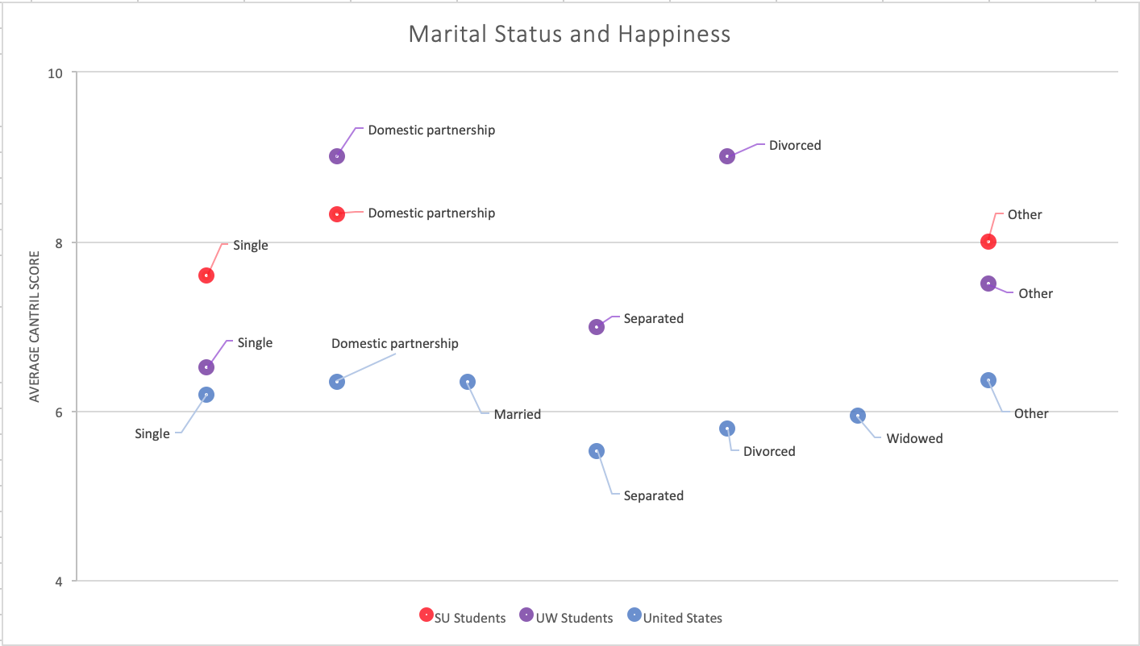
Notes:
Ciara

Slide 3
How does Marriage affect Happiness?
People who were married or in domestic partnerships had an average higher ranking on Cantril’s ladder than those who were unmarried
Robert Waldinger’s findings from the Harvard Study of Adult Development
Increase in self confidence that comes with being married
Notes:
Ciara

Slide 4
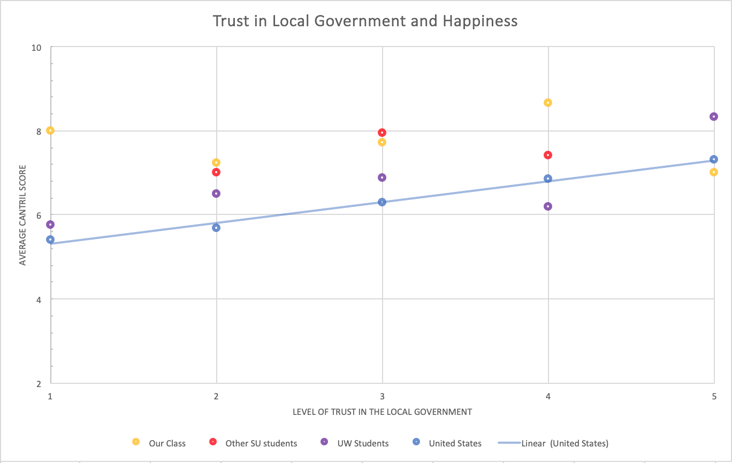

Slide 5
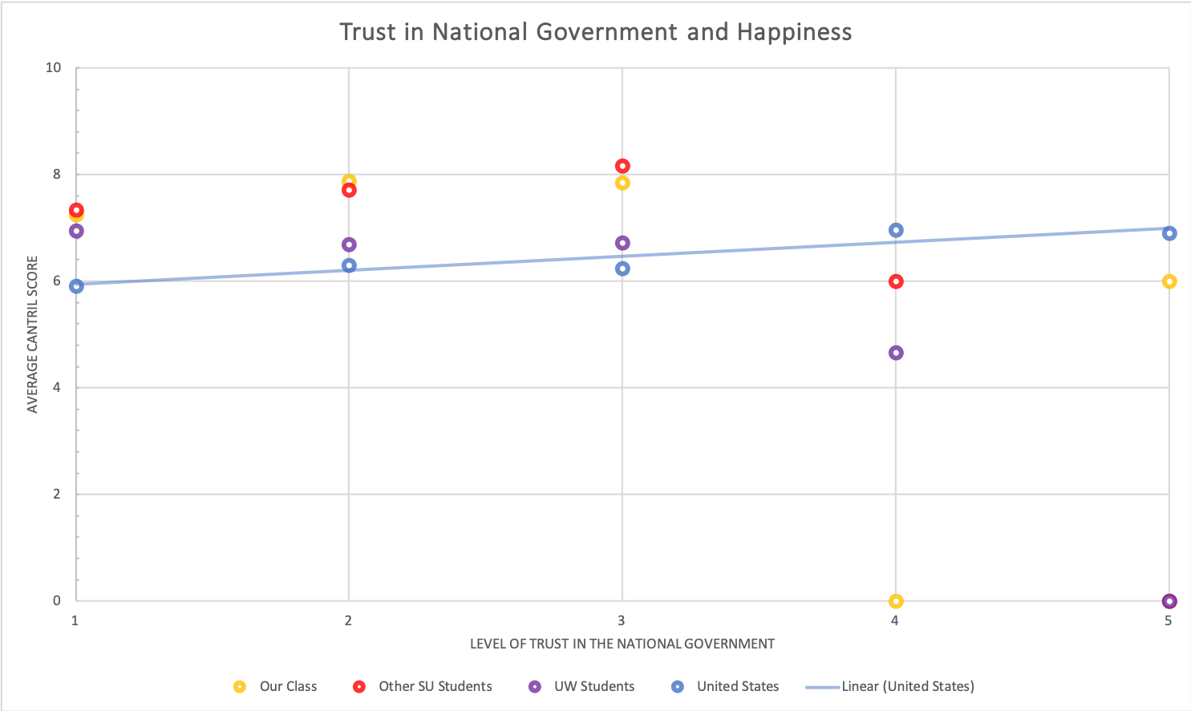

Slide 6
Case for Government: Bhutan
Bhutan’s Constitution is founded on the four pillars of Gross National Happiness (GNH):
Good Governance
Sustainable Economic Development
Promotion and Preservation of Culture
Environmental Conservation
How public policy is entwined with happiness

Slide 7
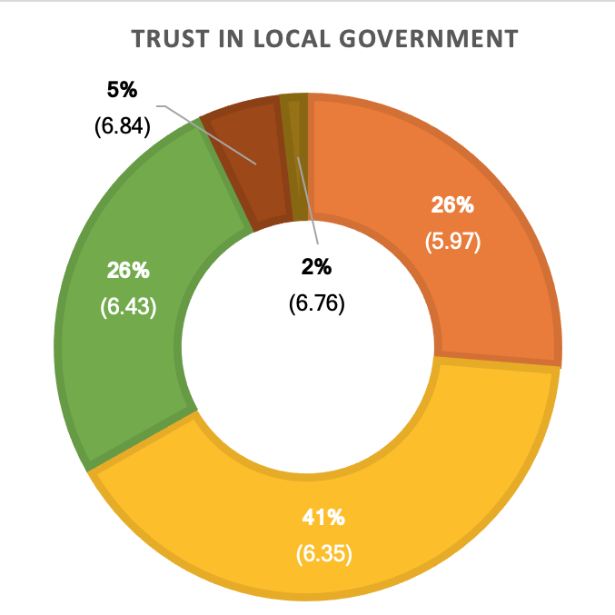
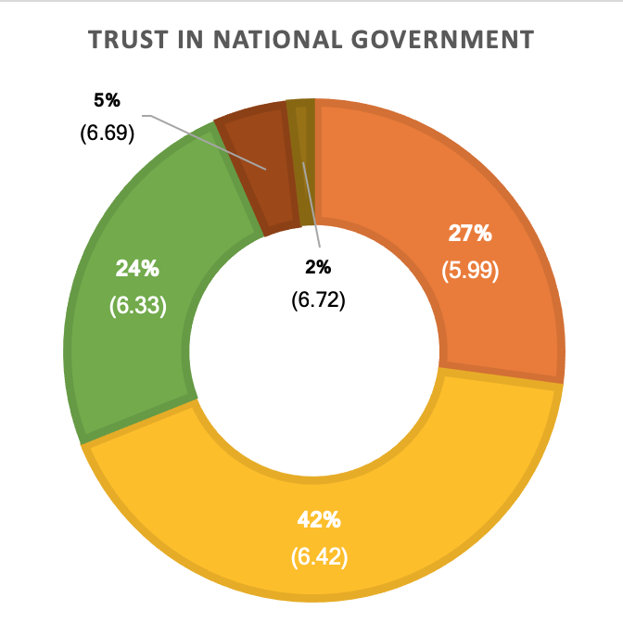
Pew
Research
Center

Slide 8
Why is trust important?
Important for the success of a wide range of public policies that depend on behavioral responses from the public
Many government policies, programmes and regulations depend on cooperation and compliance of citizens
Necessary to increase the confidence of investors and consumers
Essential for key economic activities, most notably finance
Notes:
Thomas

Slide 9
The Connection
Happiness with marriage
Acceptance
Belonging
Overcoming Challenges
Happiness with Government Performance
Trust
Notes:
Bonnie and Clyde: Being married does not nullify the u-bend, hwoever, those in marraige have a less seviere dip because they go through lifes unique challenges together

Slide 10
Thank you!

